Slide 1
HR Analysis Dashboard
Presented BY:
Prajwal r Patil
Certified Data Analyst (CDA-jan-05)
Register No: CA12202540402

Slide 2
Introduction
HR Analytics is the process of collecting, analyzing, and interpreting workforce data to improve employee management and organizational performance.
Organizations use HR analytics to understand workforce trends, improve hiring strategies, optimize employee distribution, and support business decisions.
This project focuses on analyzing employee data using Power BI to identify workforce patterns, measure HR metrics, and generate insights through interactive dashboards.
The analysis helps organizations make data-driven decisions related to workforce planning and employee management.

Slide 3
Project Overview
The HR Analytics Dashboard project aims to analyze employee data and identify factors affecting workforce distribution and organizational performance.
This project uses Power BI to transform raw HR data into meaningful visual insights using dashboards and KPIs.
The dashboard helps monitor workforce trends, hiring patterns, employee demographics, and work location distribution.

Slide 4
Objectives
• Analyze workforce trends and employee patterns
• Create an interactive dashboard using Power BI
• Monitor employee distribution and HR metrics
• Identify workforce demographic patterns
• Generate meaningful insights using visualization
• Support HR decision-making through analytics

Slide 5
Motivation for Choosing the Dataset
Why This Dataset?
Human Resource management plays an important role in organizational success and workforce productivity.
This dataset was chosen to understand employee demographics, workforce distribution, hiring trends, and diversity metrics.
Working with this dataset provides real-world experience in HR analytics, dashboard development, and business intelligence.
Reasons for Selecting This Dataset:
• Helps understand workforce distribution
• Useful for analyzing hiring trends
• Provides real-world HR problem-solving experience
• Improves dashboard development skills
• Supports data-driven HR decisions

Slide 6
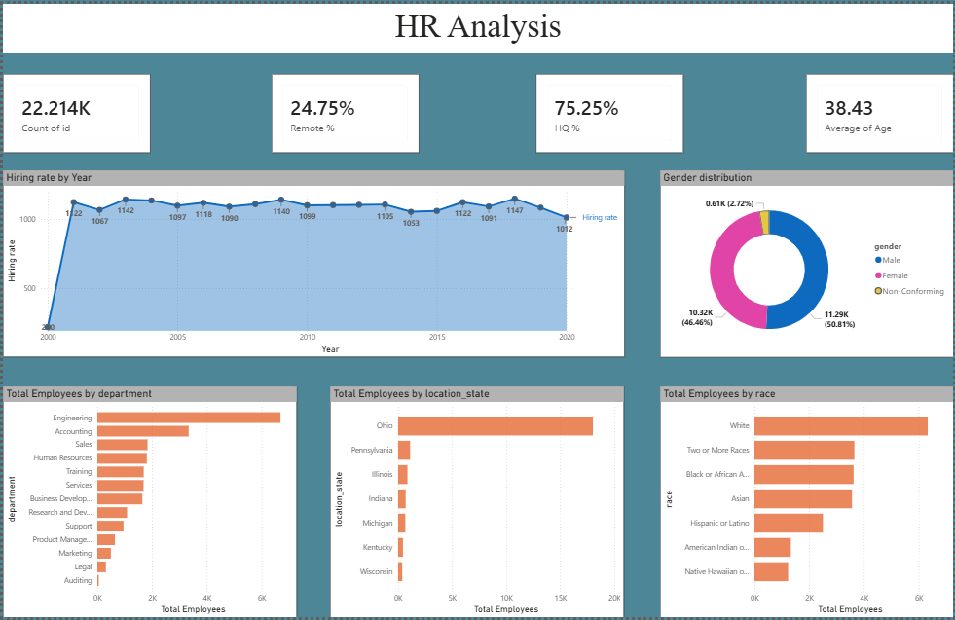
Dashboard

Slide 7
Methodology / Project Process
Step 1: Data Collection
• Imported HR dataset into Power BI
Step 2: Data Cleaning
• Removed null values
• Corrected date formats
• Fixed data type issues
Step 3: Data Transformation
• Used Power Query for preprocessing
• Created calculated columns and measures
Step 4: KPI Creation
• Total Employees
• Average Age
• Remote Employees %
• HQ Employees %
Step 5: Dashboard Development
• Created visualizations and interactive reports
Step 6: Analysis & Insights
• Identified workforce trends and generated recommendations

Slide 8
Dashboard Overview
The dashboard was developed using Power BI to visualize workforce metrics and employee patterns. Multiple charts and KPI cards were used to provide meaningful insights and improve HR decision-making.
Dashboard Components:
• KPI Cards for workforce metrics
• Line Chart for hiring trends
• Donut Chart for gender distribution
• Bar Charts for department analysis
• Map Visualization for state-wise employee distribution
• Interactive filters and slicers

Slide 9
Key Insights
• Most employees belong to specific departments
• Hiring trends changed across years
• Remote workforce represents a significant percentage
• Some states contribute more employees than others
• Workforce diversity varies across categories
• Employee distribution is uneven across departments

Slide 10
Recommendations
• Improve workforce planning strategies
• Enhance diversity initiatives
• Balance employee distribution across departments
• Strengthen remote work policies
• Use dashboard insights for better HR decisions

Slide 11
Conclusion
The HR Analytics Dashboard successfully transformed raw employee data into meaningful insights using Power BI.
The project helped analyze workforce trends, identify HR patterns, and support data-driven decision-making for improving workforce management.

Slide 12
Thank You

